Slide 1


Session 6 Scary forests full of trees

Slide 2

MAXIMUM PARSIMONY!!!! (non of that beta-parsimony here, only sigma grindset parsimonies!!!)
If it quacks like a duck, and waddle like a duck, it’s most likely a duck, not a newly evolved platypus
i.e. the least amount of evolutionary steps needed to get from a common ancestor to all analysed genotypes, is the most likely scenario.
i.e. the tree with the least mutations is the most parsimonious

Slide 3




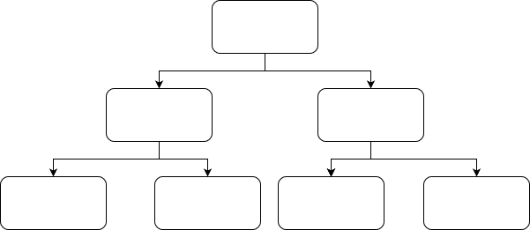
MP
A
B
C
D
LCA (Lowest/Last Common Ancestor)
MRCA
(Most Recent Common Ancestor)
CA (Common Ancestors)
Descendants
A
C
B
D
A
D
C
B
A
B
C
D

Slide 4
MP
Tree1
Tree2
Tree3
A
B
C
D
A
B
C
D
A
D
C
B
A
C
B
D
 | Tree1 | Tree2 | Tree3
Shirt
Skin
Eyes
SUM
 | Tree1 | Tree2 | Tree3
Shirt | 2 | 2 | 1
Skin
Eyes
SUM
 | Tree1 | Tree2 | Tree3
Shirt | 2 | 2 | 1
Skin | 2 | 2 | 1
Eyes
SUM
 | Tree1 | Tree2 | Tree3
Shirt | 2 | 2 | 1
Skin | 2 | 2 | 1
Eyes | 1 | 2 | 2
SUM
 | Tree1 | Tree2 | Tree3
Shirt | 2 | 2 | 1
Skin | 2 | 2 | 1
Eyes | 1 | 2 | 2
SUM | 5 | 6 | 4

Slide 5
MP
A
B
C
D
A
B
C
D
A
D
C
B
A
C
B
D
Bootstrap#1
Bootstrap#2
…
Bootstrap#N
 | Tree1 | Tree2 | Tree3
Shirt | 2 | 2 | 1
Skin | 2 | 2 | 1
SUM | 4 | 4 | 2
 | Tree1 | Tree2 | Tree3
Skin | 2 | 2 | 1
Eyes | 1 | 2 | 2
SUM | 3 | 4 | 3
 | Tree1 | Tree2 | Tree3
Shirt | 2 | 2 | 1
Eyes | 1 | 2 | 2
SUM | 3 | 4 | 3

Slide 6

MAXIMUM Likelihood!
Which tree is the most likely to represent the evolutionary paths all samples took
i.e. What combination of branch length, substitutions, nucleotide frequency and topology is the most probable to be true
i.e. Which parameters have the highest probability to reproduce the data supplied

Slide 7
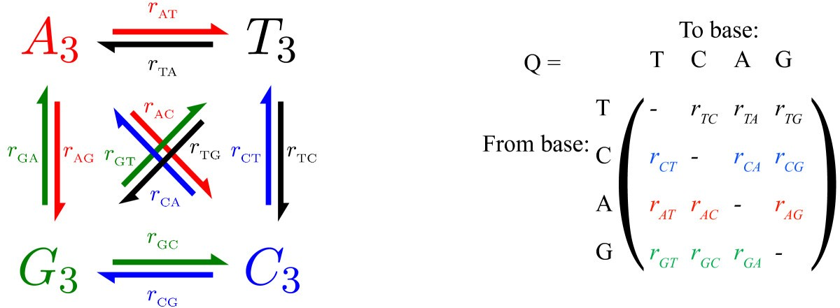
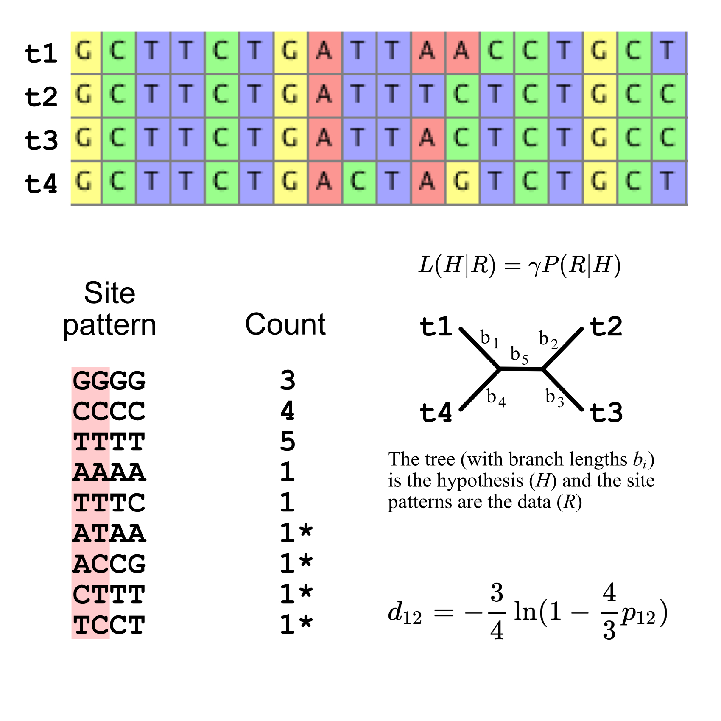
MAXIMUM Likelihood parameters
Substitution probability
Nucleotide frequency
πT, πA, πC, πG
Probability of topology and branch lengths

Slide 8
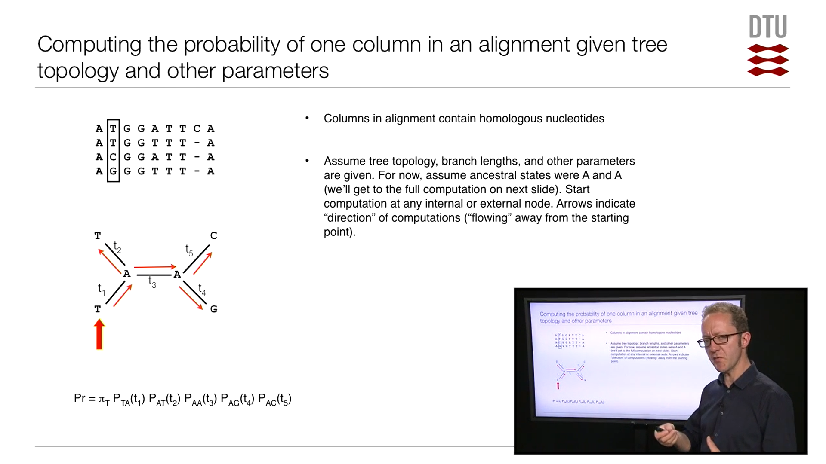
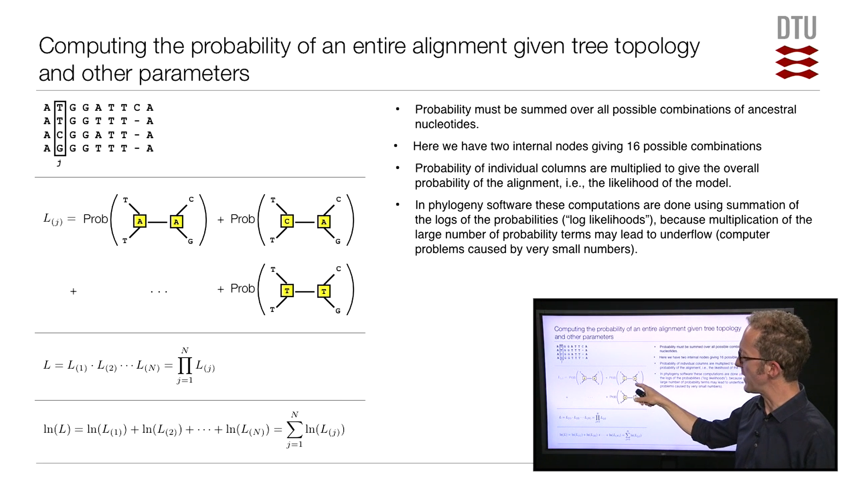
https://youtu.be/xDKUIegYpWM

Slide 9
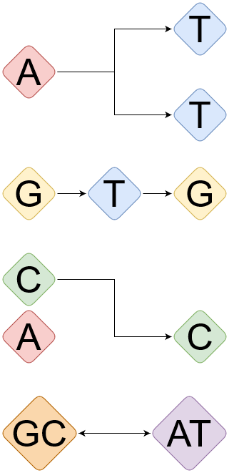
Exemptions to the rules
(substation models often take this into account afaik)
Convergent evolution
Back mutations
Horizontal gene transfer (direct exchange of DNA from non-endemic source)
Mobile vs. permanent / extremophiles

Slide 10
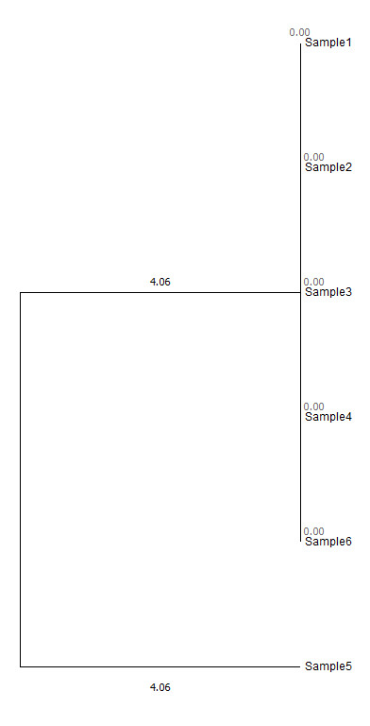
Case study 1
Regular tree
>Sample1
C
>Sample2
C
>Sample3
C
>Sample4
C
>Sample5
G
>Sample6
C
ML tree, No bootstraps, Tamura Nei substitution model,
Use all sites

Slide 11
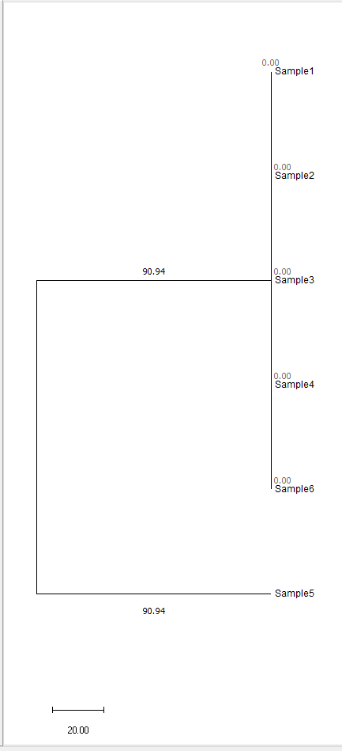
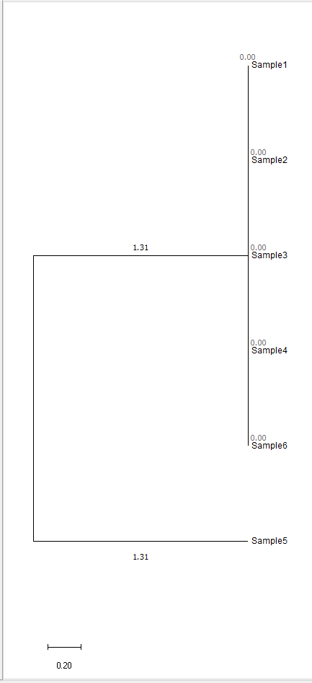
Case study 2 Missing data
>Sample1
CCCC
>Sample2
CCCC
>Sample3
CCCC
>Sample4
CCCC
>Sample5
GCCC
>Sample6
CCCC
>Sample1
CCCC
>Sample2
CCCC
>Sample3
CCCC
>Sample4
CCCC
>Sample5
GNNN
>Sample6
CCCC
Notes:
N’s don’t change topology (since there is no data available to calculate probabilities on) but will change the branch lengths This example is too small however to get proper bars

Slide 12
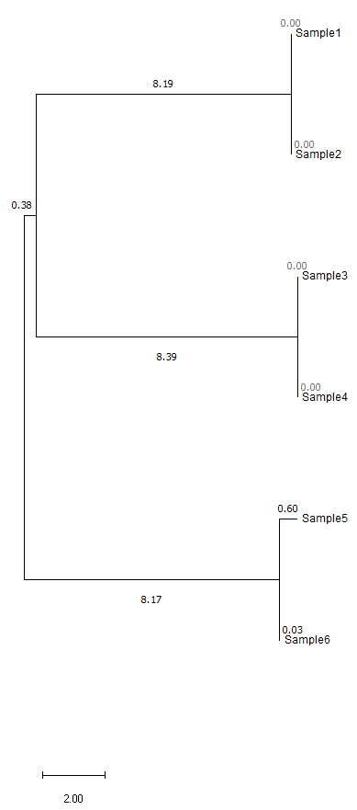
Case study 3
Three genotypes + further speciation of one
>Sample1
AC
>Sample2
AC
>Sample3
CC
>Sample4
CC
>Sample5
GG
>Sample6
GC

Slide 13
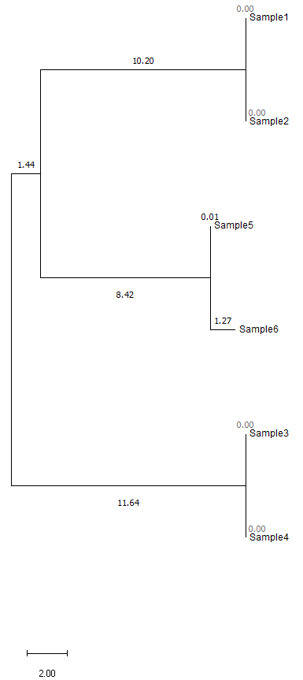
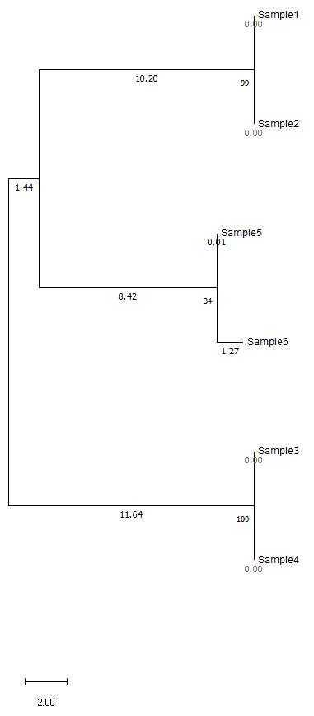
Case study 4
>Sample1
CAAAA
>Sample2
CAAAA
>Sample3
CCCCC
>Sample4
CCCCC
>Sample5
CGGGA
>Sample6
CGGGG
ML tree, 100 bootstraps, Tamura Nei substitution model,
Use all sites

Slide 14
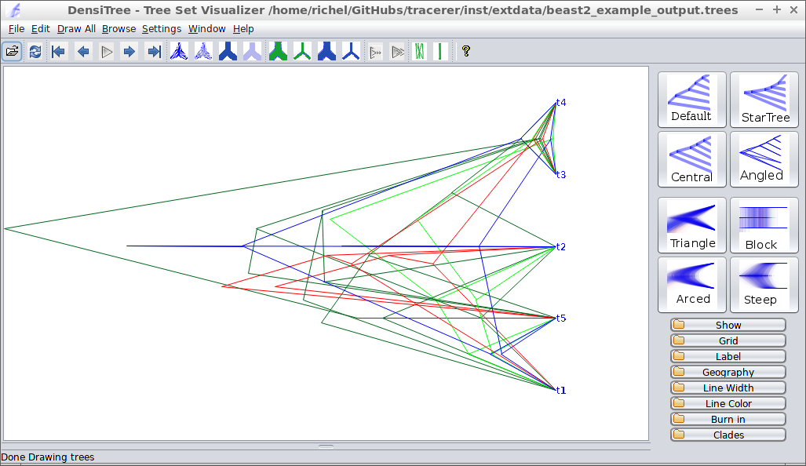
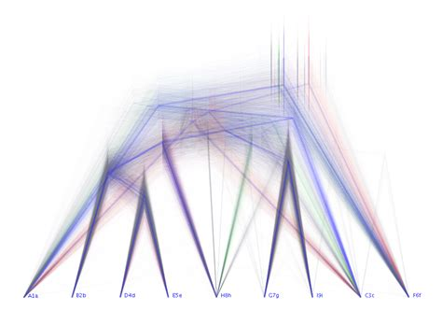
Command line tree software
Bootstrap makes trees more robust, but it’s not always able to resolve everything

Slide 15
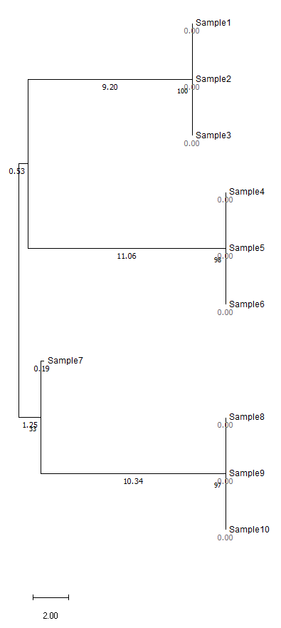
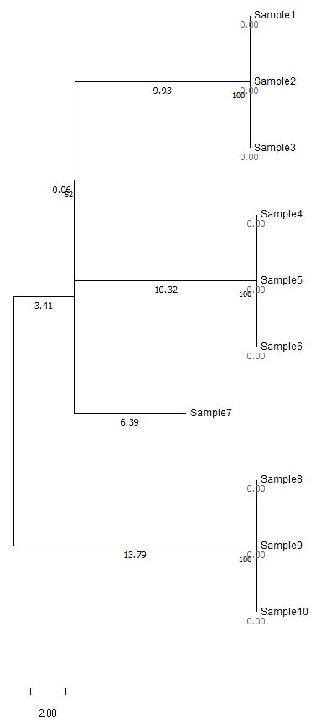
Case study 5
Partial deletion
>Sample1
AAAAAAAAAAGGGGGGGGGG
>Sample2
AAAAAAAAAAGGGGGGGGGG
>Sample3
AAAAAAAAAAGGGGGGGGGG
>Sample4
CCCCCCCCCCAAAAAAAAAA
>Sample5
CCCCCCCCCCAAAAAAAAAA
>Sample6
CCCCCCCCCCAAAAAAAAAA
>Sample7
CNNNGNANNNGANNNNCNNN
>Sample8
GGGGGGGGGGCCCCCCCCCC
>Sample9
GGGGGGGGGGCCCCCCCCCC
>Sample10
GGGGGGGGGGCCCCCCCCCC
ML tree, 100 bootstraps, Tamura Nei substitution model,
Full deletion (>=90.00001% partial deletion)

Slide 16
Case study 5
Partial deletion
>Sample1
AAAAAAAAAAGGGGGGGGGG
>Sample2
AAAAAAAAAAGGGGGGGGGG
>Sample3
AAAAAAAAAAGGGGGGGGGG
>Sample4
CCCCCCCCCCAAAAAAAAAA
>Sample5
CCCCCCCCCCAAAAAAAAAA
>Sample6
CCCCCCCCCCAAAAAAAAAA
>Sample7
CNNNGNANNNGANNNNCNNN
>Sample8
GGGGGGGGGGCCCCCCCCCC
>Sample9
GGGGGGGGGGCCCCCCCCCC
>Sample10
GGGGGGGGGGCCCCCCCCCC
>Sample1
AAAGGG
>Sample2
AAAGGG
>Sample3
AAAGGG
>Sample4
CCCAAA
>Sample5
CCCAAA
>Sample6
CCCAAA
>Sample7
CGAGAC
>Sample8
GGGCCC
>Sample9
GGGCCC
>Sample10
GGGCCC

Slide 17
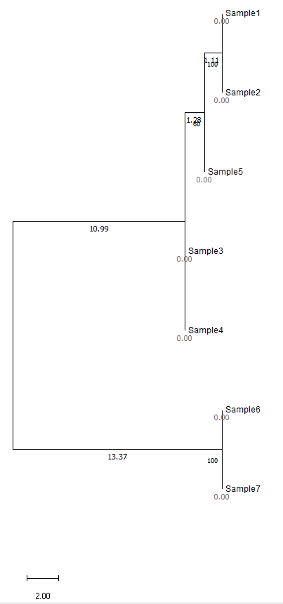


Case study 6
HGT/recombination
>Sample1
AAAAAAAAAAAAAAAAAAAA
>Sample2
AAAAAAAAAAAAAAAAAAAA
>Sample3
CCCCCCCCCCCCCCCCCCCC
>Sample4
CCCCCCCCCCCCCCCCCCCC
>Sample5
AAAAAAAAAACCCCCCCCCC
>Sample6
GGGGGGGGGGGGGGGGGGGG
>Sample7
GGGGGGGGGGGGGGGGGGGG
Notes:
HGT needs to be filtered out!

Slide 18
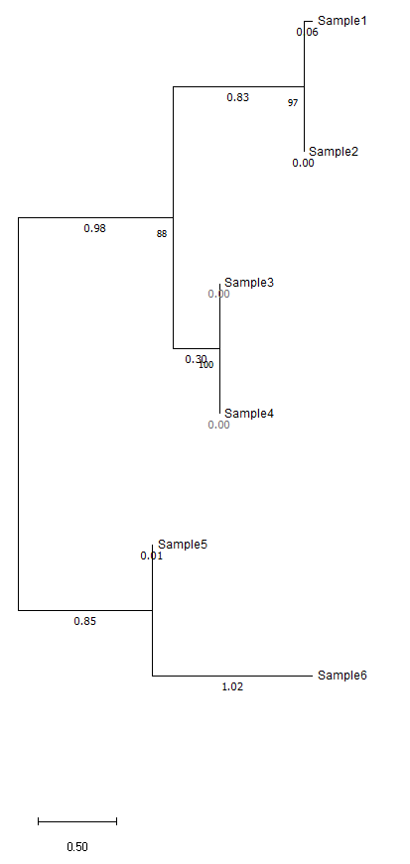
Case study 7
Large divergences = long branch lengths
>Sample1
CCCCCCCCGGGGGCCCCCCC
>Sample2
CCCCCCCCGGGGCCCCCCCC
>Sample3
AACCCCCCCCTTCCCCCCCC
>Sample4
AACCCCCCCCTTCCCCCCCC
>Sample5
AACCGGTTCCTTGTCAAAGT
>Sample6
GGGGGGGGGCCGCCCAAAGT

Slide 19
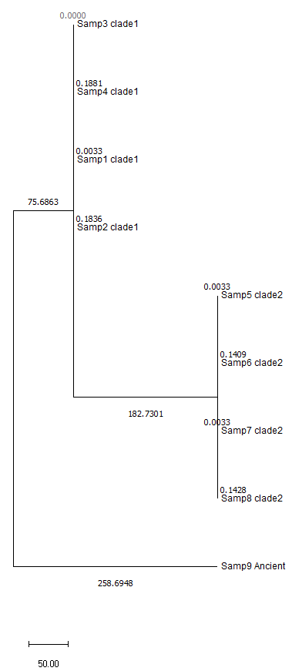
Case study 8A
Long and short branches due to N First long branches due to divergent high qual sample
>Samp1_clade1
AAAAAAAAAA
>Samp2_clade1
AAAAAAAAAT
>Samp3_clade1
AAAAAAAAAC
>Samp4_clade1
AAAAAAAAAG
>Samp5_clade2
TCAAAAAAAA
>Samp6_clade2
TCAAAAAAAT
>Samp7_clade2
TCAAAAAAAC
>Samp8_clade2
TCAAAAAAAG
>Samp9_Ancient
CAATTTACCA

Slide 20
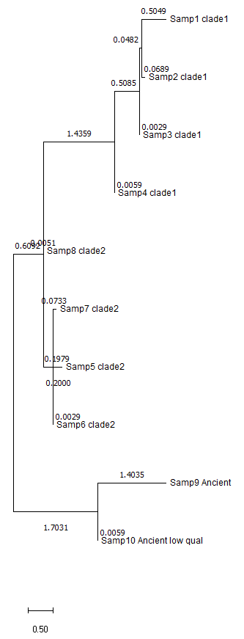
Case study 8B
Long and short branches due to N Now very short branch due to additional low qual sample
>Samp1_clade1
AAAAAAAAAA
>Samp2_clade1
AAAAAAAAAT
>Samp3_clade1
AAAAAAAAAC
>Samp4_clade1
AAAAAAAAAG
>Samp5_clade2
TCAAAAAAAA
>Samp6_clade2
TCAAAAAAAT
>Samp7_clade2
TCAAAAAAAC
>Samp8_clade2
TCAAAAAAAG
>Samp9_Ancient
CAATTTACCA
>Samp10_Ancient_low_qual
CNNTCNNNNG

Slide 21
Videos:
Max Parsimony
https://youtu.be/e9nOYbwOJm0
Max likelihood
https://youtu.be/xDKUIegYpWM

Slide 22
Command line tree software:
Maximum likelihood:
RaxML
PhyML
IQTree (really nice one, multi parameter testing)
Fastree
Etc etc…
GUI based tree software:
MEGA (RaxML, Parsimony, etc) Geneious (RaxML, PhyML, Geneious, etc) Jalview (Parsimony)
Etc etc…
Website based tree software :
EBI ClustalW2 (UPGMA, Parsminoy) Etc etc…
https://www.ebi.ac.uk/Tools/services/web/toolform.ebi?tool=clustalw2_phylogeny&sequence=clustalw2-I20141008-205527-0685-78599923-es

Slide 23
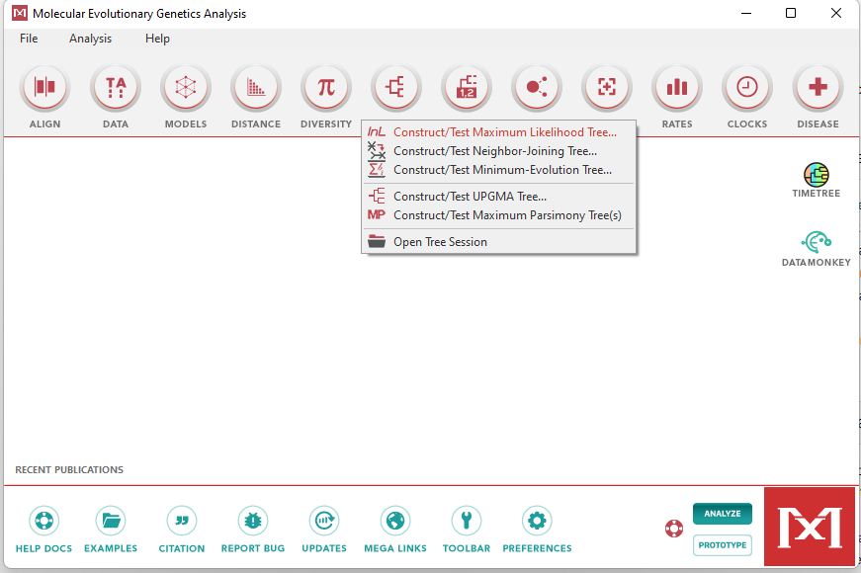
Tree building starter
Download MEGA
Molecular
Evolutionary
Genetics
Analysis
https://megasoftware.net/
Load the SNPalignment.fasta file

Slide 24
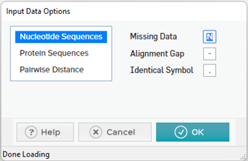
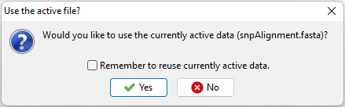
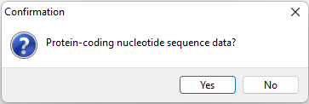
Tree building starter
Download MEGA
Molecular
Evolutionary
Genetics
Analysis
https://megasoftware.net/
Load the SNPalignment.fasta file

Slide 25
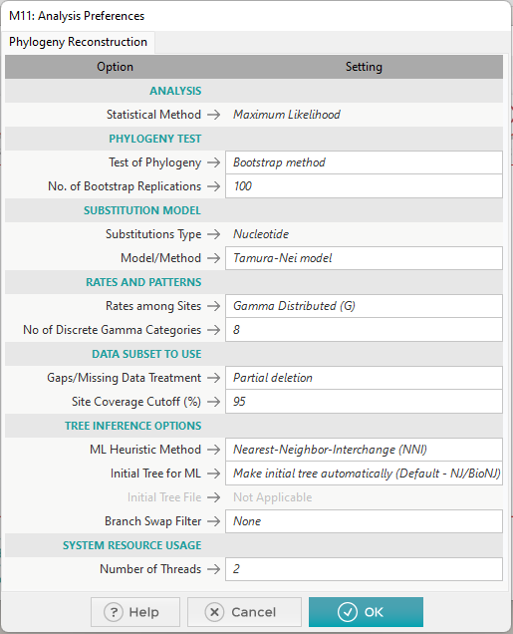
ML - tree
Maximum
Likelihood
Bootstrap is essentially subsampling x times
Model/Method are “substitution” models,
they account for the frequency of substation observed
in nature… these don’t do that much tbh
Partial deletion / full deletion / all sites
These values will determine whether or not an allele is
included based on the number of samples that have
missing data for that allele.
Keep in mind that if you have
10 samples, there is no difference between 92-95-97, since
all values equal 1 sample in 10.

Slide 26
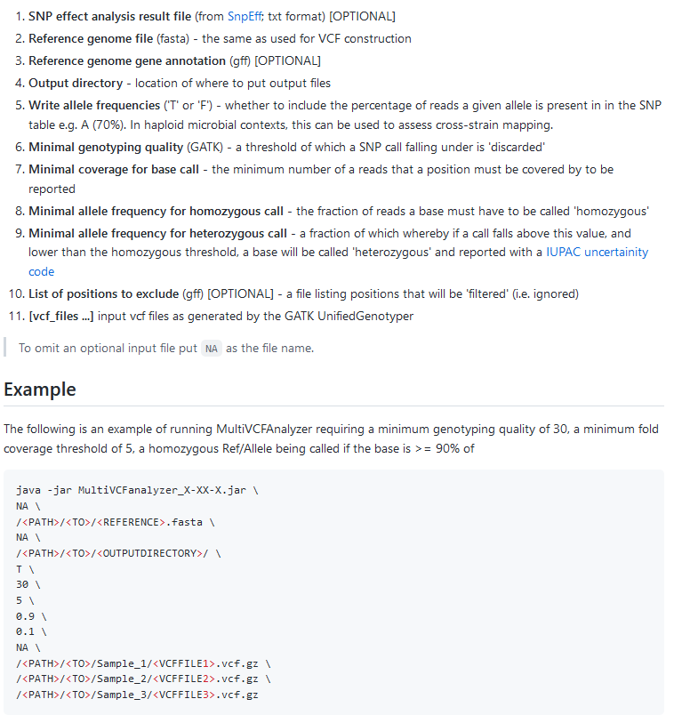
MultiVCFAnalyzer
https://github.com/alexherbig/MultiVCFAnalyzer

Slide 27
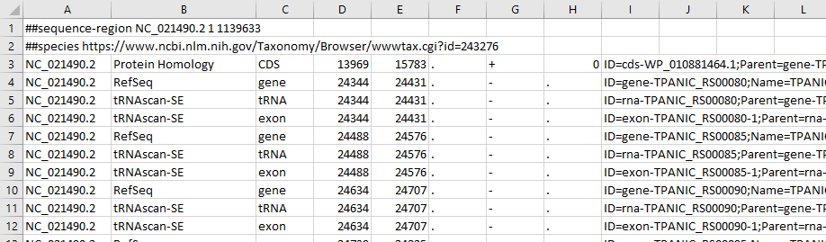
General Feature Format (GFF) and it’s most popular version 3.0 (GFF3) Using GFF to filter out features
Meta
Features
Reference
Source
Type
Start
End
Score
Strand
Frame
Gobbeldiegook,
ID is important though

Slide 28
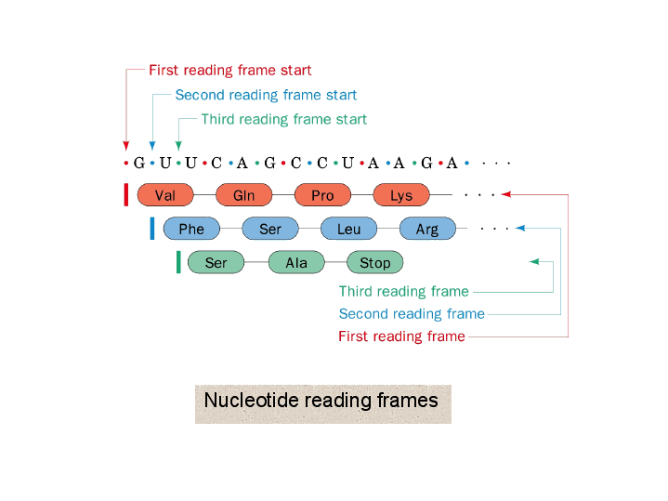
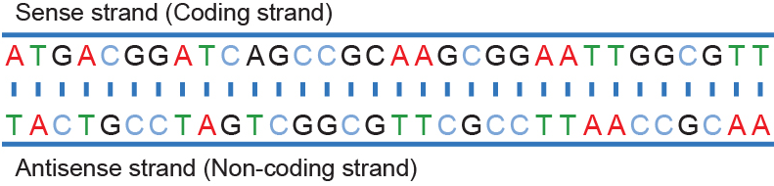
Clarification on Strand and Frame
5’ > 3’
Leading strand
Forward strand
+
Lagging strand
Reverse strand
-
3’ > 5’

Slide 29
Features to consider to filter out
Repetitive elements (things that attract non-target reads = false SNPs / increased coverage of wrong SNPs)
Method: Dustmasker, Repeatmasker, RepBase (need non-commercial free license), etc
tRNA / rRNA (transfer RNA, ribosomal RNA), highly conserved elements = attracts reads from closely related organisms
Method: Simple ‘grep’ or copy paste of lines from the original genome’s gff. If not available,
denovo annotations using Prokka. Direct mapping as a last resort and manually copy/pasting the coordinates
“Recombinant” positions, positions most likely derived through HGT
Method: ClonalFrameML, Gubbins
Low complexity regions / regions that are shared with organisms that could have piggy-backed on the capture. Method: SNPevaluation, you run a “stringent”* and “non-stringent”** eager mapping, run MultiVCFAnalyzer on your
stringently mapped VCF. You then use the SNPtable from the stringent mapped, and pick the stringent and non-stringent mapped VCFs and analyse them as mentioned in the meeting with Alexander. The profile will be added to the zip of this class, these are the parameters to check, and also you manually have
get it to show the mean coverage ratio of the non-stringent divided by the stringent.
* --bwaalnn 0.1 --bwaalnl 32 *** --bwaalnn 0.01 --bwaalnl 16

Slide 30


